Slide 1
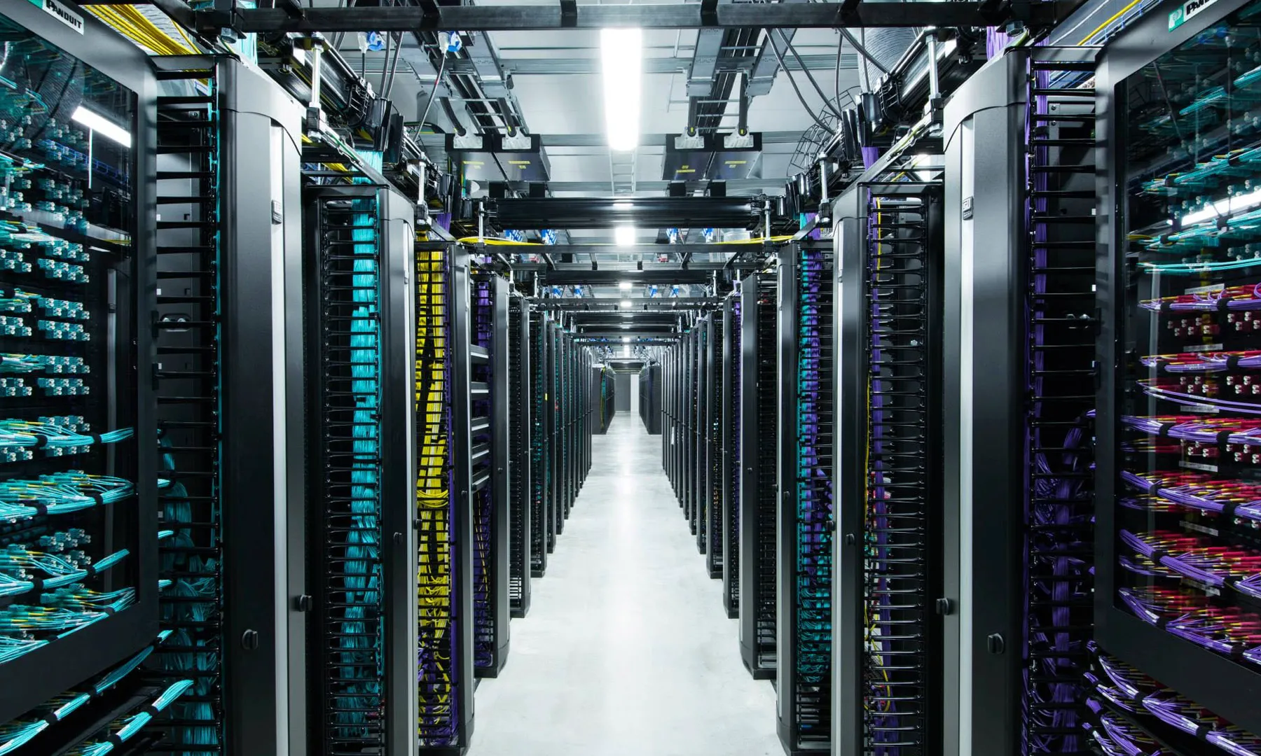
Computer Vision – Master (M2)
Food-101 Image Classification Using Transfer Learning and KNN

Slide 2
Team members
JAYAPRAKASH Divya
KARTHIKEYAN NAIR Reshma
DHANAPAL Jayasri
MODI Gurpreetkaur Jaykumar
Tarigopula Abhilash

Slide 3
Problem Statement & Motivation
Multi-class food image classification
High visual variability in food images
Applications: diet tracking, food apps, recommendations

Slide 4
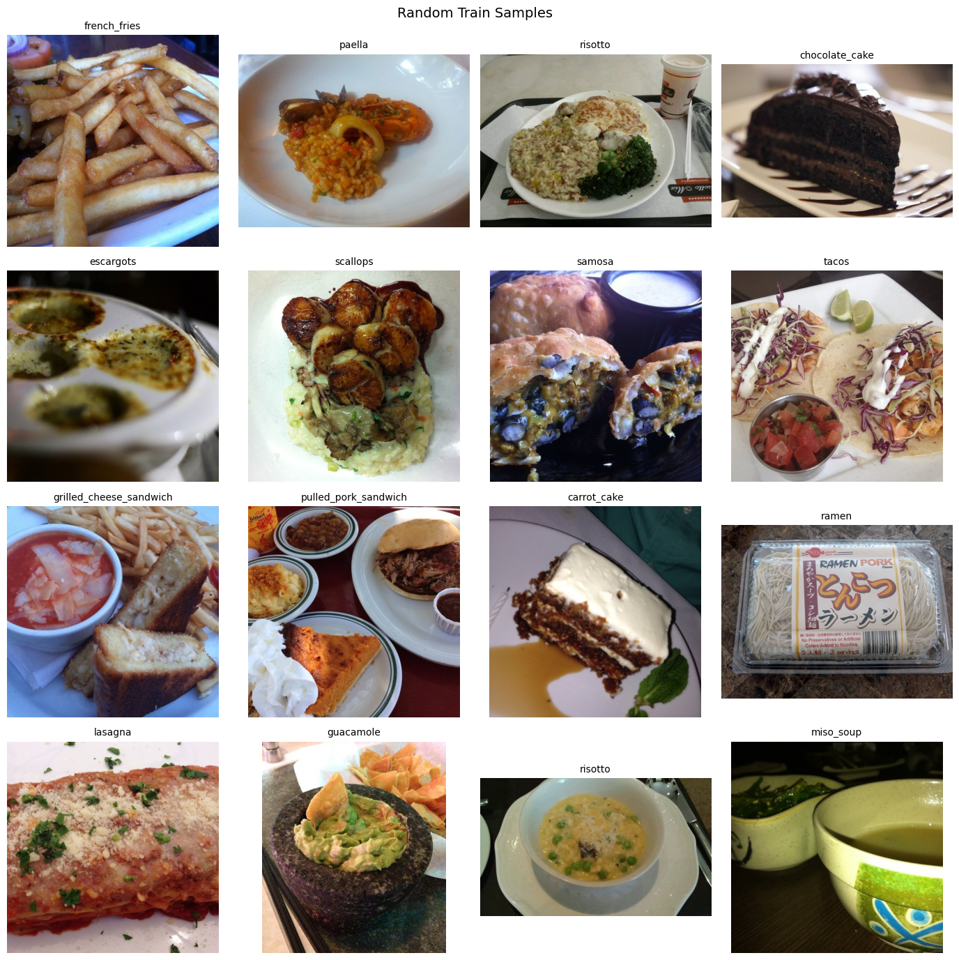
Dataset: Food-101
101 food categories
~101,000 real-world images
Subsampled to 80 images per class
Balanced train-test split

Slide 5
Overall Hybrid Approach
Deep Learning for feature extraction
Classical Machine Learning for classification
Efficient and interpretable pipeline

Slide 6
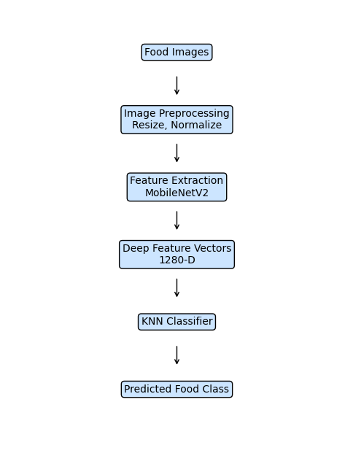
System Architecture and Flowchart

Slide 7
Feature Extraction
MobileNetV2 (ImageNet pre-trained)
Input size: 224 × 224
Classification head removed
Global Average Pooling → 1280-D features

Slide 8
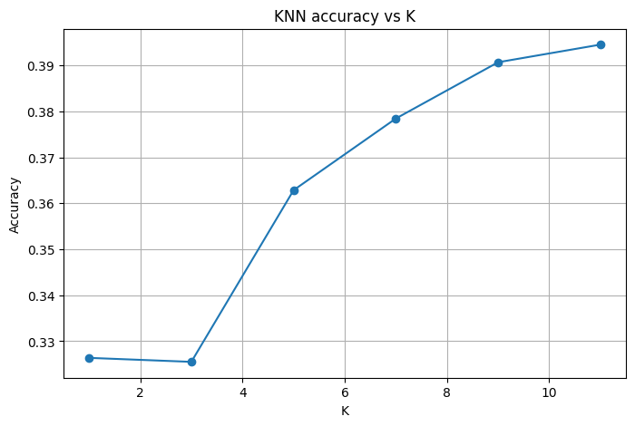
KNN Classification
Distance metric: Euclidean
K values tested: 1, 3, 5, 7, 9, 11
Accuracy increases with larger K and peaks around K = 11 (~39%), showing improved generalization and reduced sensitivity to noise.

Slide 9
KNN Classification
New item: Suppose we want to classify “chocolate_cake”.
Calculate distance: Using Euclidean distance, we find the 3 nearest items in the dataset:
apple_pie → Dessert
carrot_cake → Dessert
cheese_plate → Appetizer
Vote for class:
Desserts: 2
Appetizer: 1
Prediction: chocolate_cake is classified as Dessert
k=1 -> acc=0.3264
k=3 -> acc=0.3255
k=5 -> acc=0.3629
k=7 -> acc=0.3785
k=9 -> acc=0.3907
k=11 -> acc=0.3946

Slide 10
Experimental Setup
Google Colab with GPU
Dataset stored on Google Drive
Fixed random seed for reproducibility
Cached feature vectors

Slide 11
Results
Evaluation metrics: Accuracy, Precision, Recall, F1-score
Best K selected based on accuracy
Deep features significantly improve performance

Slide 12
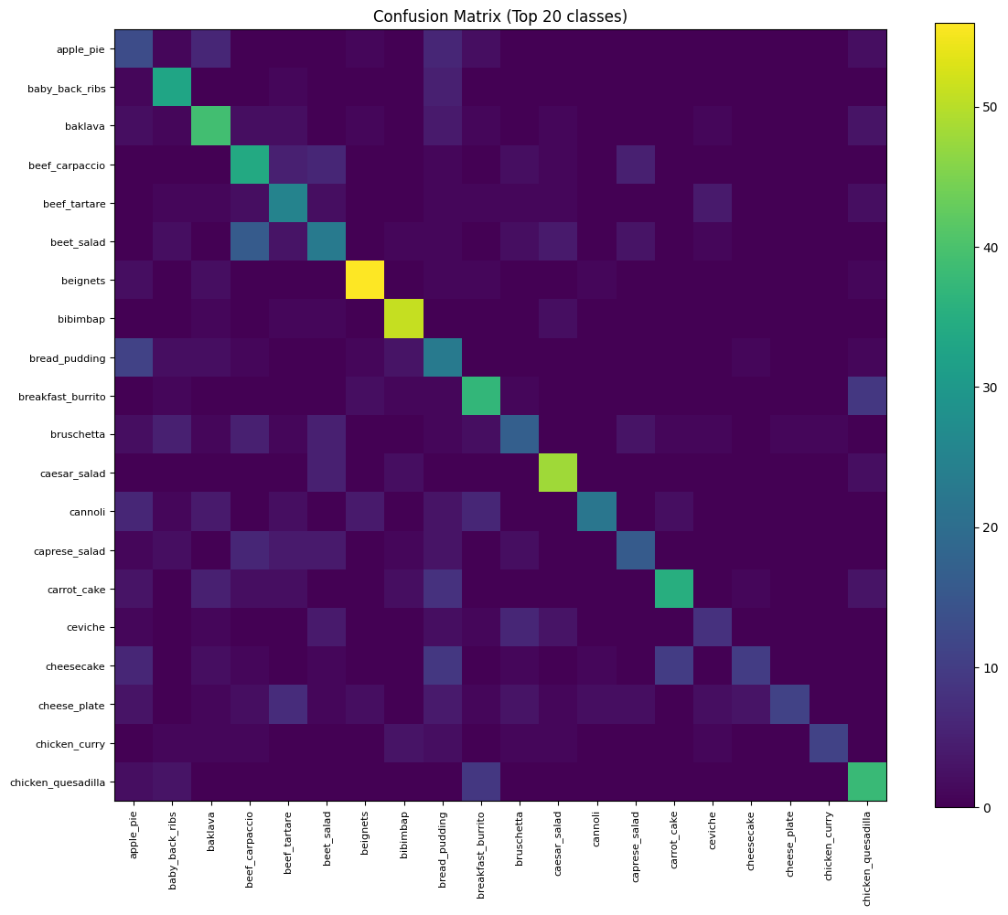
Confusion Matrix Analysis
Diagonal dominance shows correct predictions. Off-diagonal values highlight confusion between visually similar dishes.

Slide 13
Qualitative Analysis
Correct vs incorrect prediction visualization
Nearest neighbor image comparison
PCA visualization of feature space

Slide 14
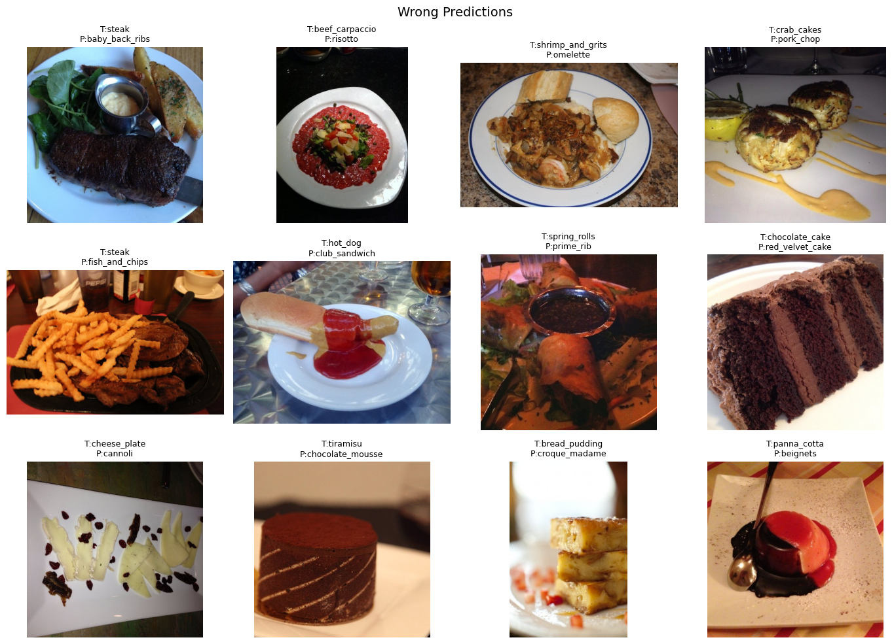
incorrect prediction visualization
Errors mainly occur between visually similar food items
Lighting and background variations affect model performance
Some dishes look very similar across different classes

Slide 15
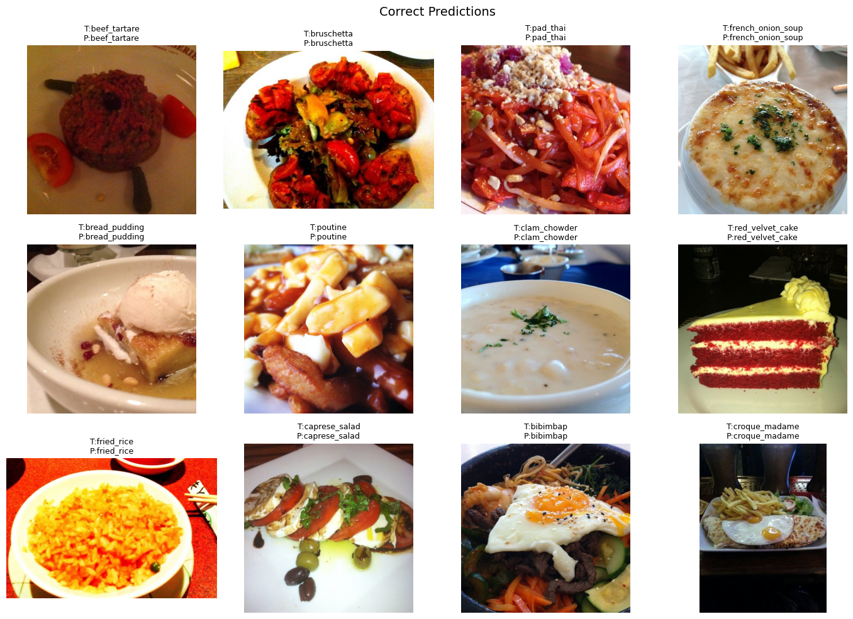
Correct prediction visualization
Model correctly identifies foods with clear visual features
MobileNetV2 extracts meaningful patterns from images
KNN performs well when class appearance is distinctive
This demonstrates the effectiveness of the hybrid approach

Slide 16
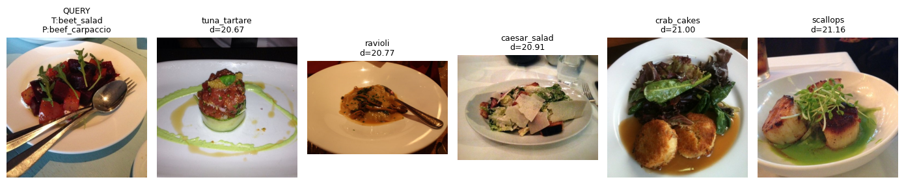
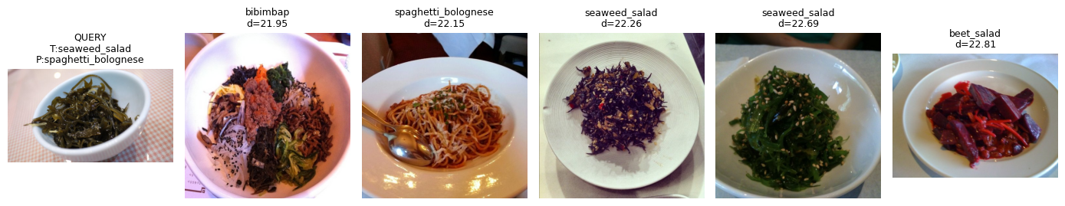
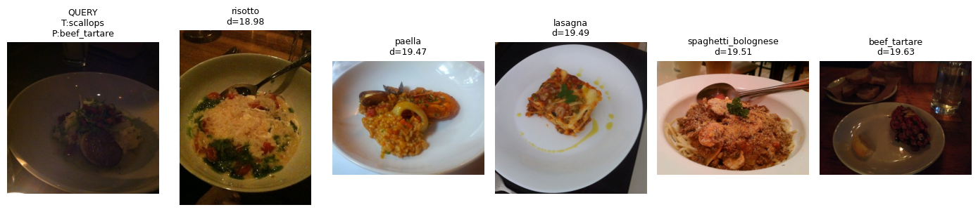
Nearest neighbor image comparison
The left image represents the query (test) image.
The images on the right are the nearest neighbors retrieved from the training set using KNN.
KNN predicts the class based on majority voting among these similar images.
Correct predictions occur when most neighbors belong to the same category.
Incorrect predictions occur when visually similar foods appear across different classes.
This visualization demonstrates how image similarity influences final classification.

Slide 17
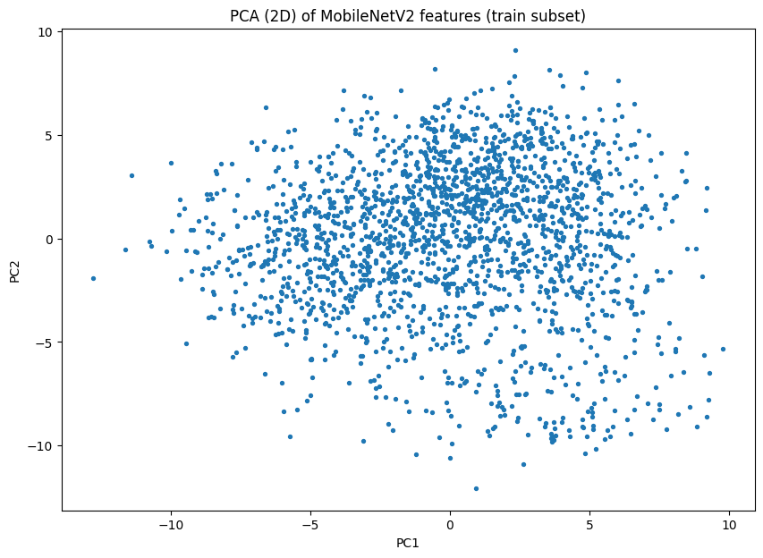
PCA Visualization
PCA projection of 1280-D MobileNetV2 features. Partial clustering exists but strong overlap explains KNN confusion.

Slide 18
Applications & Limitations
Applications: food apps, diet tracking, menu digitization
Limitations: limited data, no augmentation
KNN scalability for large datasets

Slide 19
Conclusion & Future Work
Hybrid approach is effective for food classification
MobileNetV2 provides strong representations
Future work: data augmentation, advanced models, deployment.

Slide 20
Thank You.

